Slide 1

Interface
Presented by
Hasnat Zamil
Id: 221902001
Khondokar saim id: 221902353
Cse-201
PRESENTED TO:
Md. Parvez Hossain
Dept. of CSE

Slide 2
Introduction of interface
What is interface?
Blueprint of a class.
Achieve abstract methods.

Slide 3
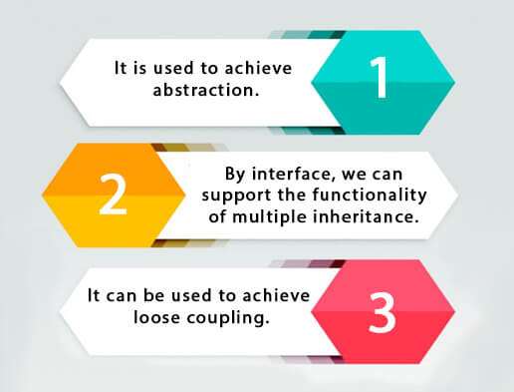
Why used interface?

Slide 4
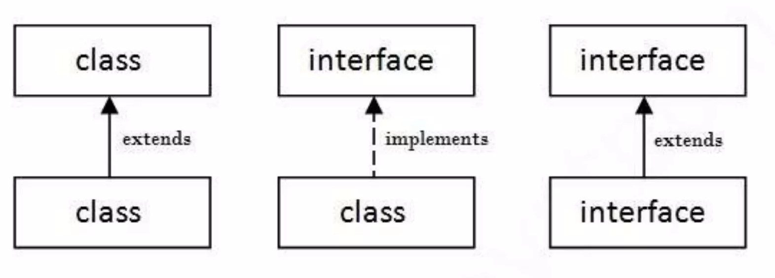
understand interface

Slide 5
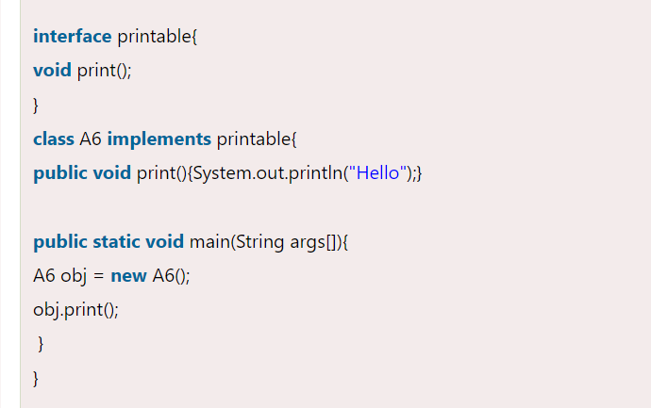
interface Example

Slide 6
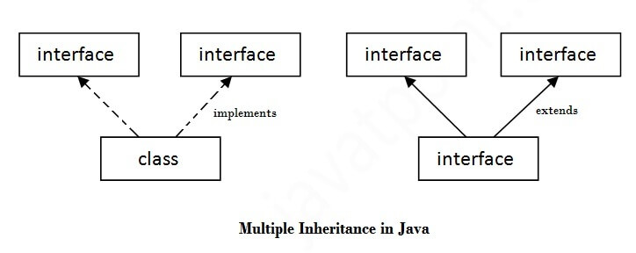
Multiple inheritance by interface

Slide 7
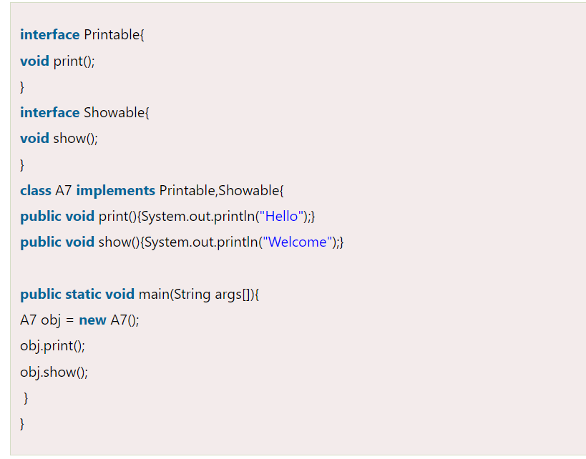
Multiple inheritance example

Slide 8
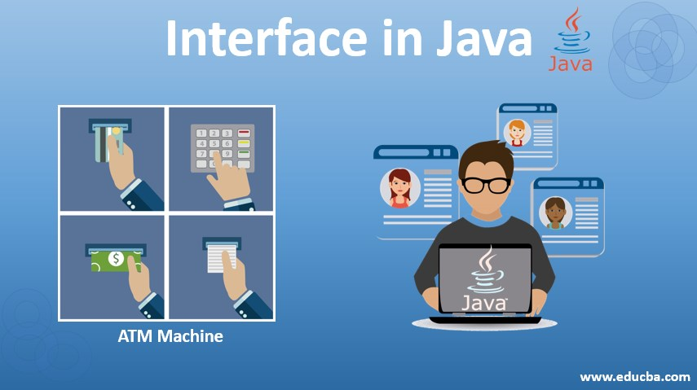
Real life example in interface

Slide 9


Thank You

